Slide 1

Kian Shen Corporation
Investors’ Conference
(Stock Code：1525)
Presenter：Chiung-Chih,Tseng General Manager
May 22,2025

Slide 2
Disclaimer
This presentation contains forward-looking statements concerning the financial condition, results of operations and businesses of Kian Shen Corporation (the "Company"). All statements other than statements of historical fact are, or may be deemed to be, forward-looking statements. Forward-looking statements are statements of future expectations that are based on management’s current expectations, assumptions, involve known, unknown risks and uncertainties that could cause actual results, performance or events to differ materially from those expressed or implied in these statements.
All forward-looking statements contained in this document are expressly qualified in their entirety by the cautionary statements contained or referred to herein. Readers should not place undue reliance on forward-looking statements. Each forward-looking statement speaks only as of the date of this presentation. Neither the Company nor any of its subsidiaries undertake any obligation to publicly update or revise any forward-looking statement as a result of new information, future events or other information. In light of these risks, results could differ materially from those stated, implied or inferred from the forward-looking statements contained in this presentation.

Slide 3
Agenda
Agenda Items | Time | Presenters
Welcome Remarks | 5 min. | Tseng, General Manager
2024 and 2025Q1 Financial Highlights | 10 min. | Chen, Manager
Future Prospects | 10 min. | Tseng, General Manager
Q & A | 15 min. | Tseng, General Manager / Chen, Manager

Slide 4
Company Profile and
Overview of the Joint Venture in China

Slide 5
Company Profile - Kian Shen Co.
1. Est. Date: October 1955 Listing Date: May 1999
2. Capital: NT$ 734 million
Land: 62,800 M²
Building: 30,113 M²
Main Products: RR Body (26%), Frame (39%),
Suspension/Stamping parts (19%)
Main Customers: China Motors (50%),
Kuozui Motors (28%) , Hotai Motors (4%) ,
RAC Electric Vehicles(4%), King Lung Auto (2%) ,
Foxtron Vehicle Technologies(2%)

Slide 6
Investment Structure
3.7%
Asteer Japan
Fuzhou Fushiang
Motor Co.,Ltd
China
Motors
43.9%
35%
Kian
Shen
Inv.
Hong
Kong
Co.,
Ltd
61.3%
Wuu Shiang
Industrial
Co., Ltd. (Taiwan)
Guangzhou
NTN-Yulon
Drivetrain Co.,Ltd
12%
Kuozui
Motors
32.9%
Kian Shen
40%
60%
NTN (China)
Investment
Corporation
100%
Xiangyang
NTN-Yulon
Drivetrain Co.,Ltd
The general
public
40%
23.2%
100%
Kian
Shen
Inv. Co.,
Ltd
(BVI)
100%
48%
NTN Japan
50%
Xiamen
King-Long
Kian-Shen
Frame Co.,Ltd.
50%
Xiamen King Long
Motor Group
Co., Ltd.

Slide 7
Joint Venture in China
Xiangyang
NTN-Yulon
Drivetrain Co., Ltd
China
Xiangyang
Fuzhou Fushiang Motor Co., Ltd
Fuzhou
Xiamen
Guangzhou NTN-Yulon Drivetrain Co., Ltd
Guangzhou
Xiamen King-Long Kian-Shen Frame Co., Ltd

Slide 8
Operating Performance -
Kian Shen Co.

Slide 9
2024 Sales Performance Overview
Market Overview
In 2024, total vehicle sales in Taiwan reached 458,000 units, representing a 4.0% year-over-year decline.
Domestic vehicle sales totaled 229,000 units, down 5.8% compared to the previous year.
Company Performance
In the first three quarters, strong demand and bulk orders boosted chassis sales.
However, a Q4 production halt and electric bus certification issues led to delays and reduced local deliveries.
Overseas sales declined due to high demand in Indonesia exceeding supply capacity.
Despite setbacks, sales exceeded expectations.
2024 revenue reached NT$1.459 billion, down 9.0% year-over-year.

Slide 10
Sales and Profit Status in the Past Five Years
NT$100 million
NT$

Slide 11
Consolidated Statement of Comprehensive Income
Unit: NT$ thousand
Accounting Title | Q1 |  | Diff. | Full year |  | Diff.
 | 2025 | 2024 | (%) | 2024 | 2023 | (%)
Net Sales | 276,927 | 308,541 | (10.2) | 1,458,634 | 1,598,496 | (8.7)
Gross Profit from Operations | 26,141 | 30,581 | (14.5) | 178,503 | 180,751 | (1.2)
Profit Margin | 9.4% | 9.9% | (0.5) | 12.2% | 11.3% | 0.9
Net Operating Income | 69 | 2,572 | (97.3) | 54,663 | 65,393 | (16.4)
Operating Profit Margin | 0.0% | 0.8% | (0.8) | 3.7% | 4.1% | (0.3)
Net Non-Operating Income | 74,215 | 63,356 | 17.1 | 331,132 | 486,786 | (32.0)
Net Investment Income from Equity Method | 53,370 | 40,296 | 32.4 | 265,531 | 454,939 | (41.6)
Other | 20,845 | 23,060 | (9.6) | 65,601 | 31,847 | 106.0
Income before Income Tax | 74,284 | 65,928 | 12.7 | 385,795 | 552,179 | (30.1)
Net Income | 58,762 | 48,487 | 21.2 | 302,164 | 403,823 | (25.2)
Net Profit Margin | 21.2% | 15.7% | 5.5 | 20.7% | 25.3% | (4.5)
Basic EPS (NT$) | 0.80 | 0.66 |  | 4.12 | 5.50

Slide 12
Sales by Product
Unit: NT$ thousand
Products | Q1 |  |  |  | Diff.
 | 2025 | % | 2024 | % | (%)
Frame | 48,181 | 17 | 65,118 | 21 | (26)
Electric bus frame | 22,812 | 8 | 6,776 | 2 | 237
RR Body | 107,645 | 39 | 127,801 | 41 | (16)
Suspension / Stamping parts | 51,285 | 19 | 80,152 | 26 | (36)
Die & Jig | 44,031 | 16 | 25,363 | 8 | (36)
Other | 2,973 | 1 | 3,331 | 2 | (11)
Total | 276,927 | 100 | 308,541 | 100 | (10)
Revenue: NT$277 million, down 10% YoY.
Decline due to paused large chassis orders and lower parts sales from Southeast Asia localization.
Platform demand softened, impacting orders.
Electric bus chassis sales increased year-over-year.

Slide 13
Income Recognized from Joint Ventures
Unit: NT$ thousand
Joint Ventures | Q1 |  |  |  | Diff.
 | 2025 | % | 2024 | % | (%)
Fuzhou Fushiang | 13,831 | 26 | 3,454 | 9 | 300
Guangzhou NTN-Yulon | 36,630 | 69 | 22,780 | 57 | 61
Xiangyang NTN-Yulon | (799) | (2) | 12,553 | 31 | (106)
Xiamen King-Long Kian-Shen | 3,708 | 7 | 1,509 | 3 | 146
Total | 53,370 | 100 | 40,296 | 100 | 32
Income: NT$53.37 million, up 32% YoY.
Growth driven by strong NEV market in China.
Fuzhou Fuxiang benefited from Xiaomi EV orders.
Xiamen King Long-Kian Shen chassis business remained steady.

Slide 14
Quarterly Consolidated Balance Sheet
Unit: NT$ thousand
 | 2025/3/31 |  | 2024/12/31 |  | 2024/3/31
Accounting Title | Amount | % | Amount | % | Amount | %
Current Assets | 2,492,981 | 42 | 2,538,720 | 43 | 2,463,790 | 42
Non-Current Assets | 3,432,498 | 58 | 3,317,187 | 57 | 3,346,370 | 58
Total Assets | 5,925,479 | 100 | 5,855,907 | 100 | 5,810,160 | 100
Current Liabilities | 521,505 | 9 | 608,576 | 10 | 629,494 | 11
Non-Current Liabilities | 269,194 | 4 | 257,229 | 5 | 273,822 | 5
Total Liabilities | 790,699 | 13 | 865,805 | 15 | 903,316 | 16
Total Equity | 5,134,780 | 87 | 4,990,102 | 85 | 4,906,844 | 84
Book Value Per Share | 69.96 |  | 67.99 |  | 66.85
Cash decreased slightly compared to year-end and the same period last year, while key financial indicators remain strong. Debt ratio has declined, reflecting a stable financial position.

Slide 15
Notice of Cash Dividend
Distribution for the Year 2024
Cash Dividend per Share NT$3.1/share
Payout Ratio 75%
Dividend Yield 5.1%
※Dividend yield is calculated based on a NT$3.1 dividend and a stock price of NT$60.4 as of March 7.
※The 2024 dividend proposal will be submitted for approval at the May 26 shareholders’ meeting.

Slide 16
Future Outlook
Prospects of Taiwan's Commercial Vehicle Market
Outlook for operations of China investment companies

Slide 17
Future Outlook
SUNWI Co., Ltd. released the 'lightweight frame' collaborating between SUNWI and KIAN SHEN at the commercial vehicle expo on May 1st of this year. Using the one-piece lightweight C-shaped frame manufactured by KIAN SHEN, which can significantly reduce the weight by 500 kilograms, decrease fuel consumption and reduce carbon emissions. The production method also differs from traditional techniques, effectively lowering production costs, being energy-efficient and environmentally friendly. It has also passed the safety inspection for a small number of vehicle types by the Ministry of Transportation.
Lightweight & Good value
ESG low carbon production
(SUNWI/KIAN SHEN)
Safety & Easy to maintenance
Lightweight C-shaped frame cross-section

Slide 18
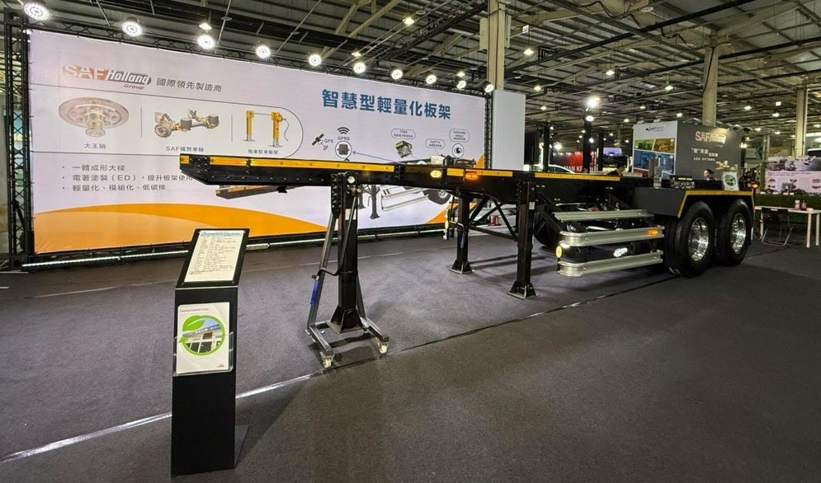
Future Outlook
SUNWI vs. KIAN SHEN
Display of Completed Lightweight Board Frame

Slide 19


